Slide 1


Data Analysis Using Python
Lecture:
Python Regular Expression (RegEX)
www.bennett.edu.in
Notes:
Add Caption : Expect More
1

Slide 2
Regular Expressions
Python Regular Expressions, or RegEX, are handy tools for pattern matching and manipulating strings.
Python regex offers a fast method for searching, matching, and manipulating text based on predefined patterns.
Python regex may significantly improve your programming abilities, whether you're validating user input, parsing data, or extracting information from massive text files.

Slide 3
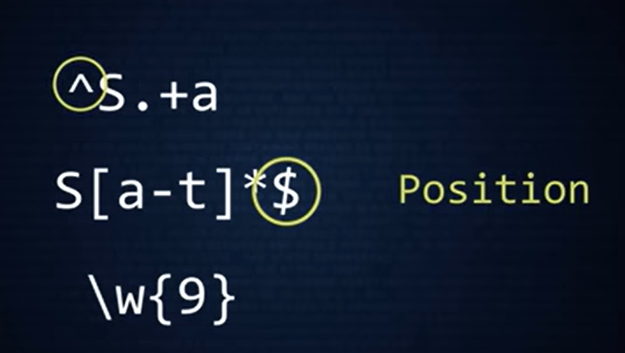
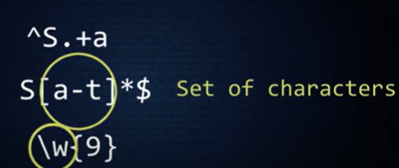
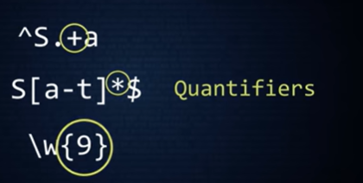

Slide 4
Special Characters
. (Dot): Matches any character except a newline.
^ (Caret): Matches the start of the string.
$ (Dollar Sign): Matches the end of the string.
[] (Square Brackets): Matches any one of the characters inside the brackets.
\ (Backslash): Escapes special characters or signals a particular sequence.
Special Sequences
\d: Matches any digit. \D: Matches any non-digit character.
\s: Matches any whitespace character. \S: Matches any non-whitespace character.
\w: Matches any alphanumeric character. \W: Matches any non-alphanumeric character.
Quantifiers
*: Matches 0 or more repetitions of the preceding pattern.
+: Matches 1 or more repetitions of the preceding pattern.
?: Matches 0 or 1 repetition of the preceding pattern.
{n}: Matches exactly n repetitions of the preceding pattern.
{n,}: Matches n or more repetitions of the preceding pattern.
{n,m}: Matches between n and m repetitions of the preceding pattern.
These quantifiers allow to define how many times a particular pattern should be repeated, giving control over the range of matches we want to capture.

Slide 5
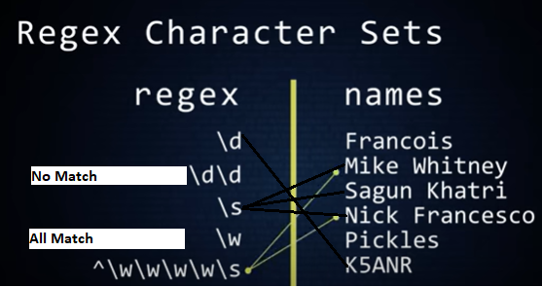

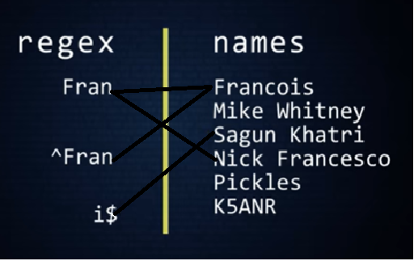
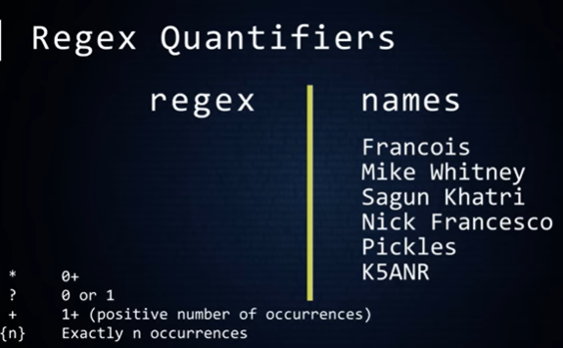
Quantifiers : Tells the number of copies of an expression

Slide 6
Regex Module in Python
A collection of functions for working with regular expressions can be found in Python’s 're' module. It enables you to search, match, and work with text using particular patterns. The following are some of the main ideas and features of the 're' module:
1. Importing the Module
Before using regex functions, you need to import the ‘re’ module:
import re
2. Basic Functions
search()
Searches a string for a match and returns a match object if found.
match = re.search(r'\d+', 'There are 123 apples')
print(match.group()) # Output: 123

Slide 7
The ‘search()’ function searches the string for a match and returns a match object if found.
import re
text = "The price is 123 dollars"
match = re.search(r'\d+', text)
if match:
print("Found a match:", match.group()) # Output: Found a match: 123

Slide 8
match()
Checks if the beginning of a string matches the pattern.
e.g. 1:
match = re.match(r'Hello', 'Hello, world!')
print(match.group()) # Output: Hello
e.g. 2:
import re
text = "Hello, world!"
match = re.match(r'Hello', text)
if match:
print("Found a match:", match.group()) # Output: Found a match: Hello

Slide 9
findall() function
Finds all matches of a pattern in a string and returns a list of matches.
matches = re.findall(r'\d+', '123 apples and 456 oranges')
print(matches) # Output: ['123', '456’]
import re
text = "123 apples and 456 oranges"
matches = re.findall(r'\d+', text)
print("All matches:", matches) # Output: All matches: ['123', '456']

Slide 10
sub() function
Replaces matches of a pattern with a specified string.
e.g. 1:
result = re.sub(r'apples', 'bananas', 'I like apples')
print(result) # Output: I like bananas
e.g. 2:
import re
text = "I like apples"
result = re.sub(r'apples', 'bananas', text)
print("Replaced text:", result) # Output: Replaced text: I like bananas

Slide 11
Compiling Patterns
For better performance, especially for patterns used multiple times, compile the regex pattern using ‘re.compile()’.
e.g. 1:
pattern = re.compile(r'\d+')
matches = pattern.findall('123 apples and 456 oranges')
print(matches) # Output: ['123', '456’]
e.g. 2:
import re
pattern = re.compile(r'\d+')
text = "123 apples and 456 oranges"
matches = pattern.findall(text)
print("All matches:", matches) # Output: All matches: ['123', '456']

Slide 12
Example
Here's a practical example of using RegEx to extract email addresses from a text.
import re
text = """
Contact us at support@example.com for more information.
You can also reach out to sales@example.com or marketing@example.net.
"""

Slide 13
# Define the regex pattern for email addresses
email_pattern = r'[a-zA-Z0-9._%+-]+@[a-zA-Z0-9.-]+\.[a-zA-Z]{2,}'
# Use findall() to extract all email addresses
email_addresses = re.findall(email_pattern, text)
# Print the extracted email addresses
print("Extracted email addresses:", email_addresses)
# Output: Extracted email addresses: ['support@example.com', 'sales@example.com', 'marketing@example.net']

